Slide 1

BANSAL COLLEGE OF ENGINEERING
MANDIDEEP, BHOPAL (M.P.)
Major Project Presentation
On
“ Quick Fix : Study Stuff Provider Application ”
Session : 2020-2021
Department of Computer Science Engineering
Under the guidance of :
Prof. Anirudh Vyas
Department of Computer
Science & Engineering
Presented by :
Sneh Gour (0127CS171093)
Sahil Yadav (0127CS171077)
Harshit Chouhan (0127ME171014)
CSE, VII Semester, 4th Year

Slide 2
Contents
Project Name
Project Profile & Purpose
System Requirements
SDLC Model Used
System Design
Tools & Technology Used
Testing
Pros & Cons
Future Enhancement
Conclusion
Snapshots
ER – Diagram
Use Case Diagram
DFD
Modules

Slide 3
Quick Fix : A Study Stuff Provider Application

Slide 4
Project Profile & Purpose
This application is basically for students. It allows the student to exchange, buy or sell their study material which they don’t need anymore after once it is used, for example, books of previous semester.
In this application ,students can easily find stuff related to their study materials and other things, such as notes, books, guides or other equipments.

Slide 5
System Requirements
Minimum Hardware Requirements :
Pentium II or higher
256 MB RAM
1 GB hard free drive space
Minimum Software Requirements :
OS (Windows Vista, Mac OS X, Linux, Solaris)
Java 8 and above
MySql for database

Slide 6
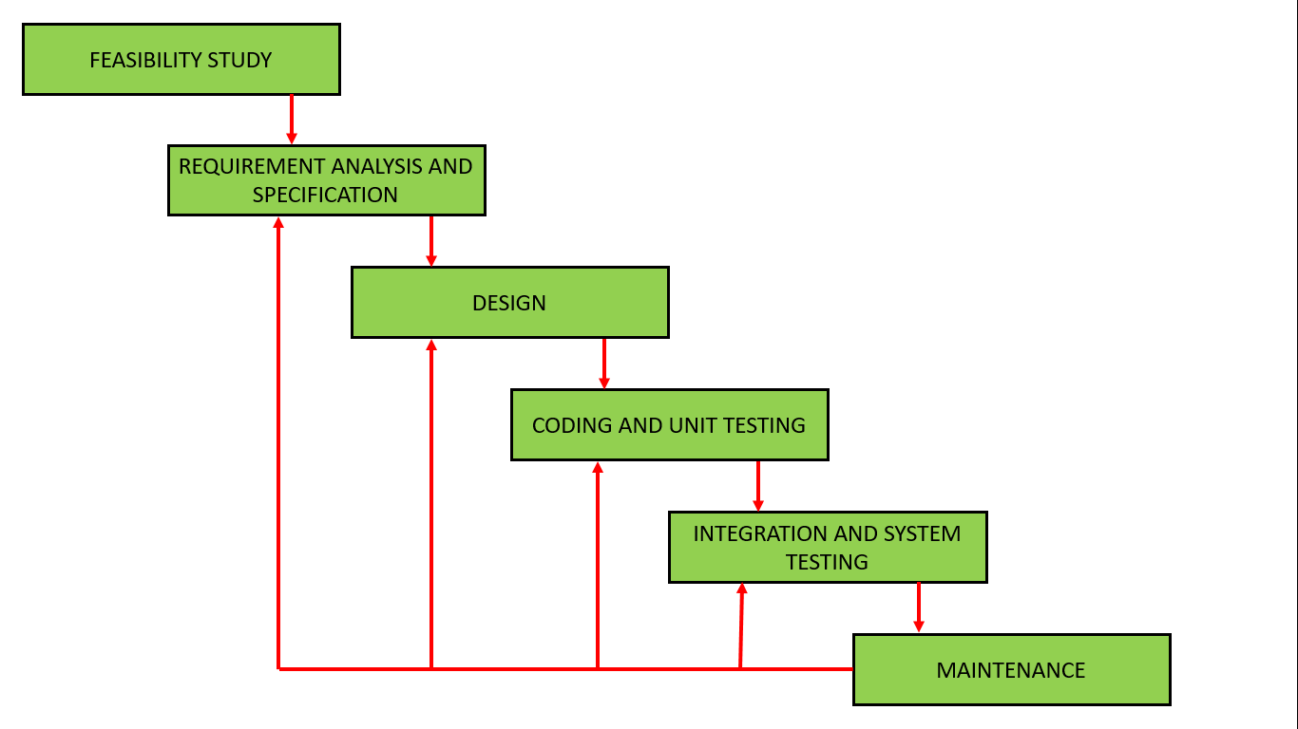
SDLC Model Used
ITERATIVE WATERFALL MODEL

Slide 7
ER- Diagram
Contact
Price
I_image
Name
E-mail
I_name
Buy
or
Sell
I_id
User
(Buyer/Seller)
N
N
Item
Contact
State
Password
Description
Username
City
N
Manages
1
Admin

Slide 8

Use Case Diagram
Add Items
Sell Items
<<include>>
User
Buy Items
Password
<<include>>
Username
<<include>>
Admin
Login
<<extend>>
Forgot Password
Registration
<<include>>
Username
(e-mail)
<<include>>
Seller
Buyer
Share
Create Password

Slide 9
Data Flow Diagram (DFD)
Quick Fix : A Study Stuff Provider Application
Seller
Sell
Buy
Buyer
Info
Request
Level – 0 DFD (Context Diagram)

Slide 10
Registration
Sign Up
Information
User
Account Details
Username
Valid
Password
Access Over Databases
User
Add Item
Enter details
Admin
Login
For sell
Seller
Info
Item Details
Access List
For buy
Sell Item
Buy Item
Buyer
Access Item
Level – 1 DFD

Slide 11
Modules
Login Activity
Login
Registration/Create Account
Create Username
Create Password
B) Homepage
Home
Seller
Buyer
Contact Us
About Us
Feedback
Logout

Slide 12
Modules
C) User/Buyer
Login
Create Account
View all list
See Details
Buy through contact details
D) User/Seller
Login
Create Account
Add item to sell
See item list
Remove sold items

Slide 13
Tools & Technology Used
For Front End : Core Java
For Back End : MySql Database
For Connectivity: JDBC (Java Database Connectivity)

Slide 14
Testing
Unit testing
Integration testing
System testing
Alpha (α) testing

Slide 15
Pros & Cons
Pros :
Study material will be easily available.
Stuff will be reused, & not waste.
Cons :
Users of one organization can not access stuff listed in system of other organization.

Slide 16
Future Enhancement
Android/Web application
E-mails for getting information.
Order by app directly/delivery system.
Payment methods.
Stuff will divided into category.

Slide 17
Conclusion
This is an application, promotes reusability, it is to decrease the rate of wastage of student’s study materials that have been used before.
Here we are providing a platform where students can easily get all the necessary stuff.

Slide 18
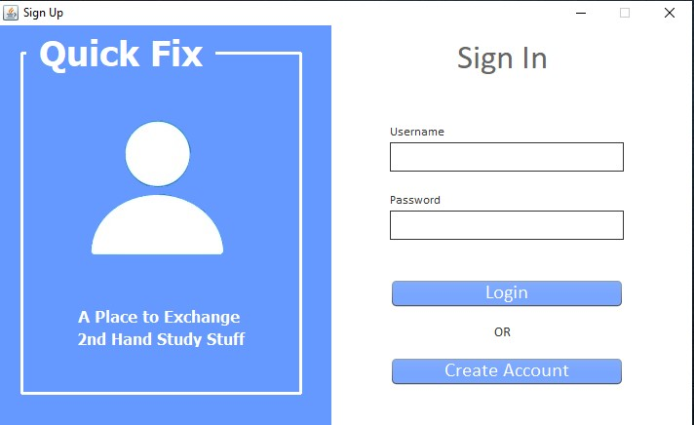

Slide 19
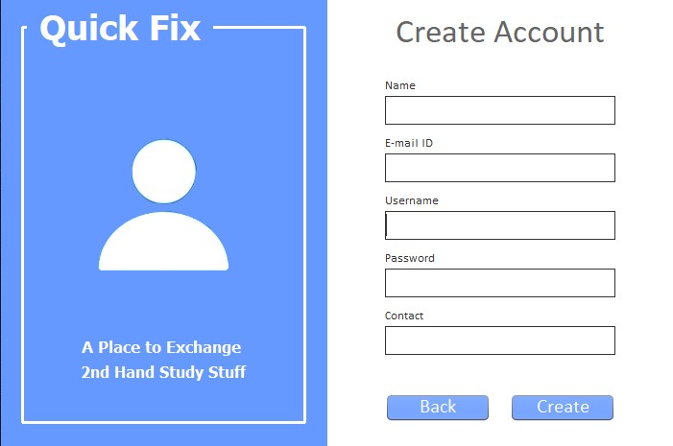

Slide 20
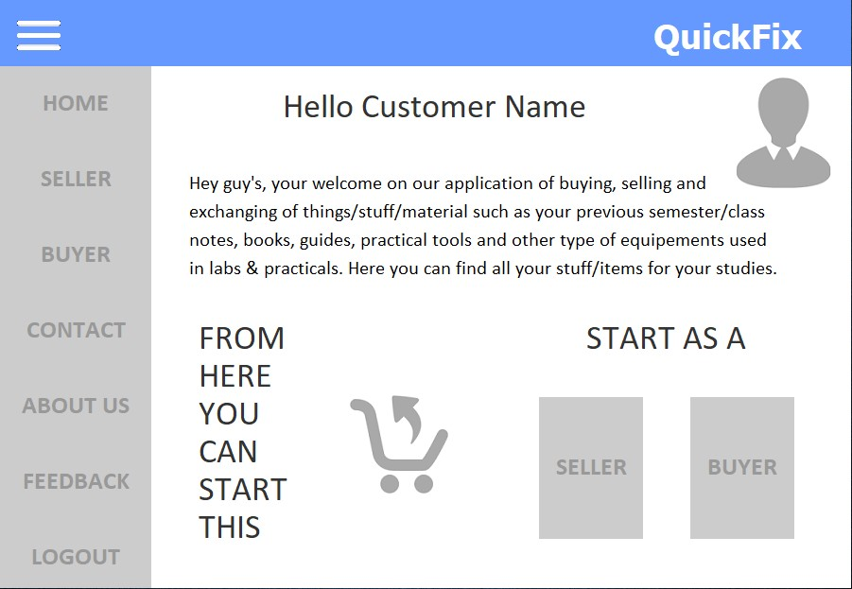

Slide 21
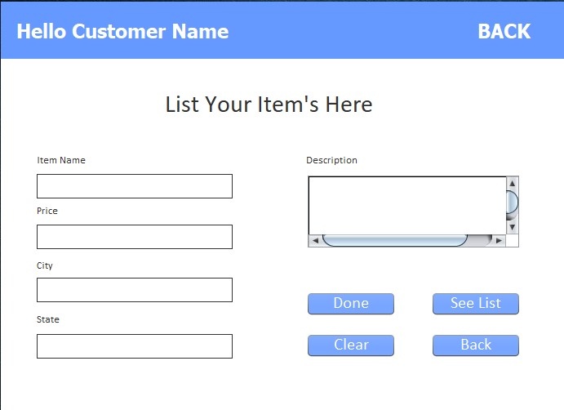

Slide 22
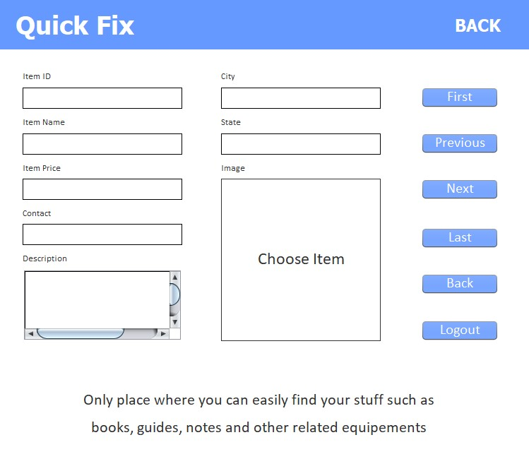

Slide 23
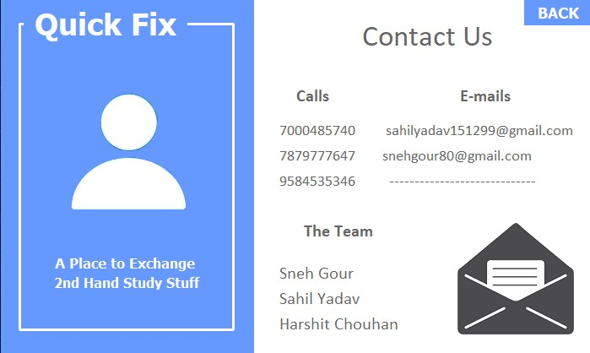

Slide 24
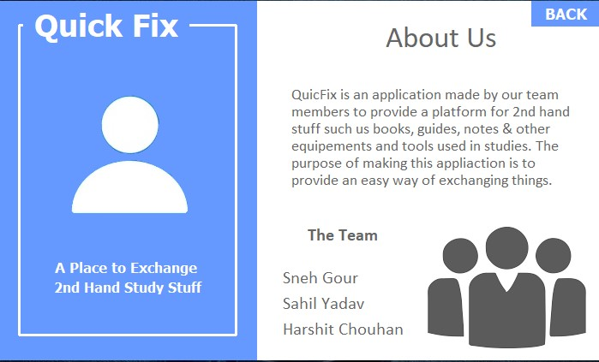

Slide 25
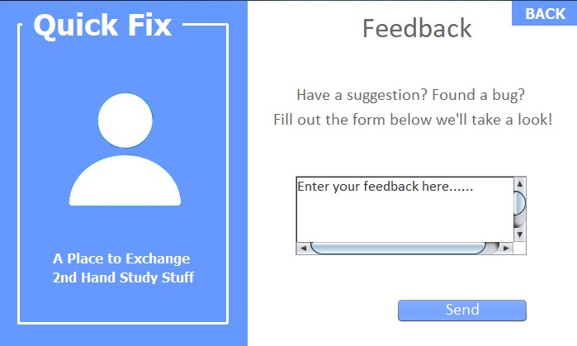

Slide 26
THANK YOU

